Slide 1
Support Vector Machines and Kernels
Doing Really Well with
Linear Decision Surfaces

Slide 2
Linear Separators
Training instances
x ∈ ℜ^{n}
y ∈ {-1, 1}
w ∈ ℜ^{n}
b ∈ ℜ
Hyperplane
<w, x> + b = 0
w₁x₁ + w₂x₂ … + w_{n}x_{n} + b = 0
Decision function
f(x) = sign(<w, x> + b)
Math Review
Inner (dot) product:
<a, b> = a · b = ∑ a_{i}*b_{i}
= a₁b₁ + a₂b₂ + …+a_{n}b_{n}

Slide 3
Intuitions
O
X
O
X
O
X
X
O
O
X
O
X
X
O
O
X

Slide 4
Intuitions
O
X
O
X
O
X
X
O
O
X
O
X
X
O
O
X

Slide 5
Intuitions
O
X
O
X
O
X
X
O
O
X
O
X
X
O
O
X

Slide 6
Intuitions
O
X
O
X
O
X
X
O
O
X
O
X
X
O
O
X

Slide 7
A “Good” Separator
O
X
O
X
O
X
X
O
O
X
O
X
X
O
O
X

Slide 8
Noise in the Observations
O
X
O
X
O
X
X
O
O
X
O
X
X
O
O
X

Slide 9
Ruling Out Some Separators
O
X
O
X
O
X
X
O
O
X
O
X
X
O
O
X

Slide 10
Lots of Noise
O
X
O
X
O
X
X
O
O
X
O
X
X
O
O
X

Slide 11
Maximizing the Margin
O
X
O
X
O
X
X
O
O
X
O
X
X
O
O
X

Slide 12
“Fat” Separators
O
X
O
X
O
X
X
O
O
X
O
X
X
O
O
X

Slide 13
Why Maximize Margin?
Increasing margin reduces capacity
Must restrict capacity to generalize
m training instances
2^{m} ways to label them
What if function class that can separate them all?
Shatters the training instances
VC Dimension is largest m such that function class can shatter some set of m points

Slide 14
VC Dimension Example
X
O
X
X
X
X
X
X
O
X
X
O
O
O
X
O
O
X
X
O
O
O
O
O

Slide 15
Support Vectors
O
X
O
X
O
X
X
O
O
X
O
X
X
O
O
X

Slide 16
The Math
For perfect classification, we want
y_{i} (<w,x_{i}> + b) ≥ 0 for all i
Why?
To maximize the margin, we want
w that minimizes |w|²

Slide 17
Dual Optimization Problem
Maximize over α
W(α) = Σ_{i} α_{i} - 1/2 Σ_{i,j} α_{i} α_{j} y_{i} y_{j} <x_{i}, x_{j}>
Subject to
α_{i} ≥ 0
Σ_{i} α_{i} y_{i} = 0
Decision function
f(x) = sign(Σ_{i} α_{i} y_{i} <x, x_{i}> + b)

Slide 18
primal/dual problems
Reference material (click on below link): https://www.youtube.com/watch?v=OR-xXUmBtYU
KKT conditions:
https://www.youtube.com/watch?v=vx7d32Jz97w

Slide 19
What if Data Are Not Perfectly Linearly Separable?
Cannot find w and b that satisfy
y_{i} (<w,x_{i}> + b) ≥ 1 for all i
Introduce slack variables ξ_{i}
y_{i} (<w,x_{i}> + b) ≥ 1 - ξ_{i} for all i
Minimize
|w|² + C Σ ξ_{i}

Slide 20
Strengths of SVMs
Good generalization in theory
Good generalization in practice
Work well with few training instances
Find globally best model
Efficient algorithms
Amenable to the kernel trick …

Slide 21
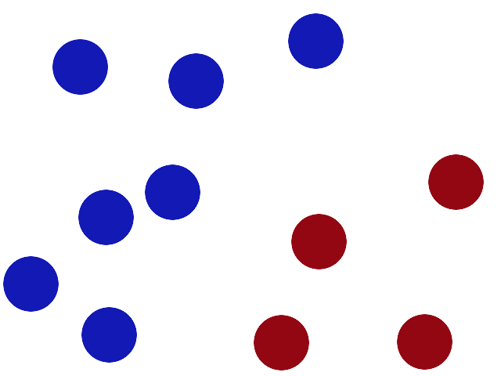
Simple example
We have 2 colors of balls on the table that we want to separate.

Slide 22
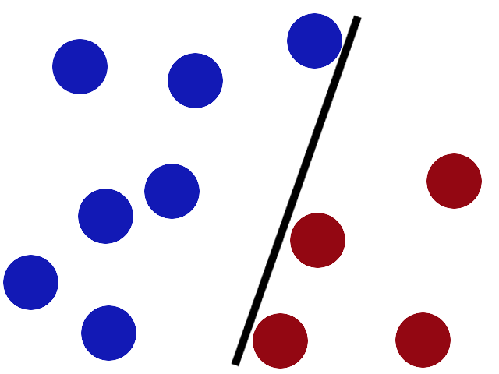
We get a stick and put it on the table, this works pretty well right?

Slide 23
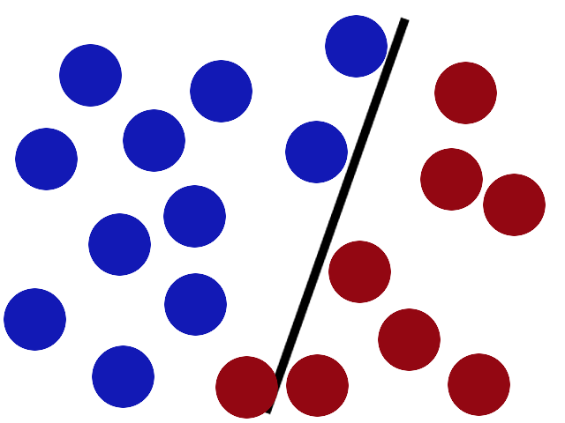
Some villain comes and places more balls on the table, it kind of works but one of the balls is on the wrong side and there is probably a better place to put the stick now.

Slide 24
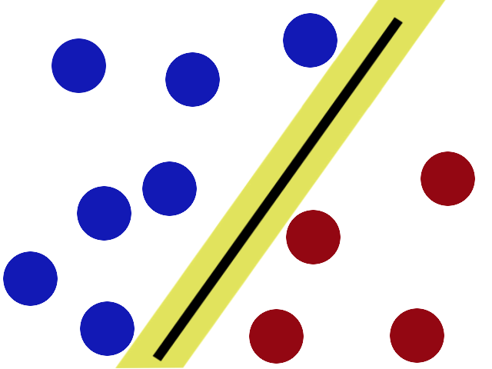
SVMs try to put the stick in the best possible place by having as big a gap on either side of the stick as possible.

Slide 25
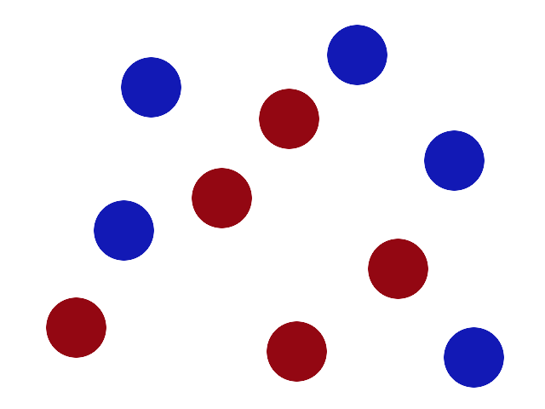
There is another trick in the SVM toolbox that is even more important. Say the villain has seen how good you are with a stick so he gives you a new challenge.

Slide 26
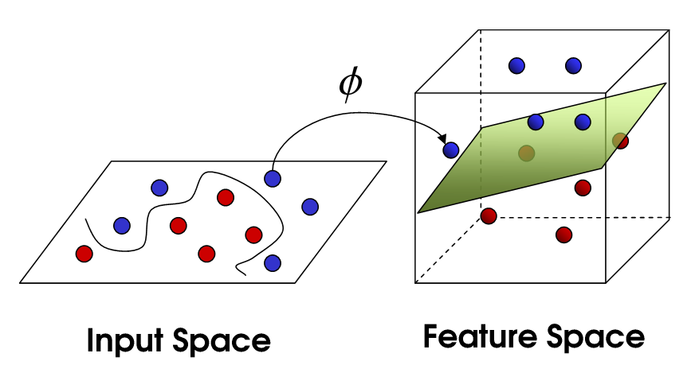
There’s no stick in the world that will let you split those balls well, so what do you do? You flip the table of course! Throwing the balls into the air. Then, with your pro ninja skills, you grab a sheet of paper and slip it between the balls.

Slide 27
Here,
Boring adults call the balls data,
the stick is a classifier,
the biggest gap trick is called optimization,
flipping the table is called kernelling and
the piece of paper a hyperplane.

Slide 28
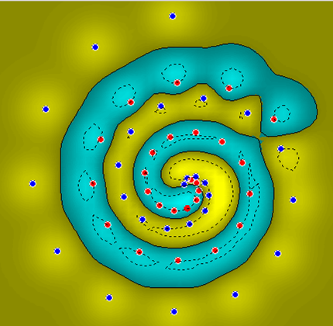
What if Surface is Non-Linear?
O
O
O
O
O
O
O
O
O
O
X
O
X
X
O
X
O
X
X
O
O
O
O
O
O
O
Image from http://www.atrandomresearch.com/iclass/

Slide 29
Soft Margins
This idea is based on a simple premise: allow SVM to make a certain number of mistakes and keep margin as wide as possible so that other points can still be classified correctly.
This can be done simply by modifying the objective of SVM.

Slide 30
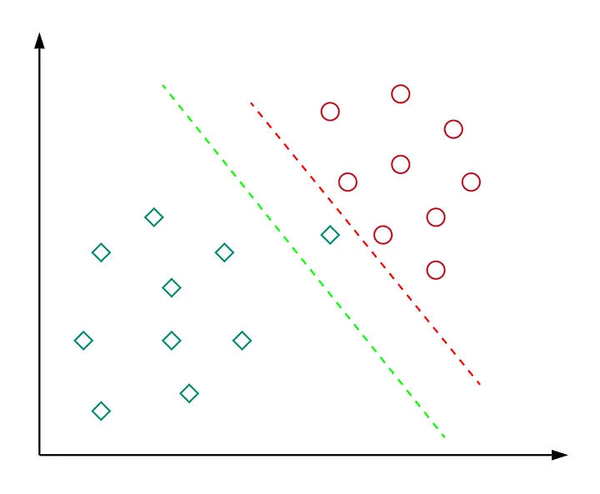
The green decision boundary has a wider margin that would allow it to generalize well on unseen data. In this event, soft margin formulation helps to avoid the overfitting issues.

Slide 31

How it Works (mathematically)?
Aim to minimize the following objective:
This differs from the original objective in the second term. Here, C is is a hyperparameter that decides the trade-off between maximizing the margin and minimizing the mistakes. When C is small classification mistakes are given less importance and focus is more on maximizing the margin. Similarly, When C is large, the focus is more on avoiding misclassification at the expense of keeping the margin small.

Slide 32
Kernel Methods
Making the Non-Linear Linear

Slide 33
When Linear Separators Fail
x₂
x₁²
X
X
X
X
x₁
O
O
x₁
X
X
O
O
O
O
X
X
O
O
Note: Kernels are a way to solve non-linear problems with the help of linear classifiers. This is known as the kernel trick method.

Slide 34
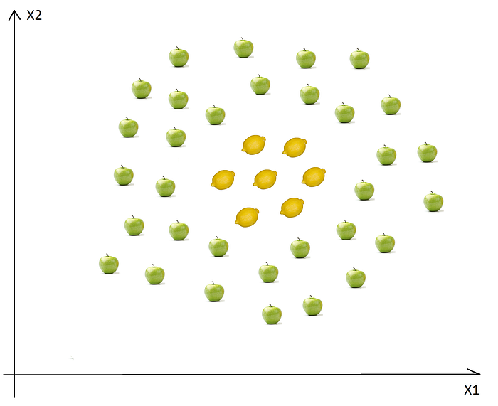
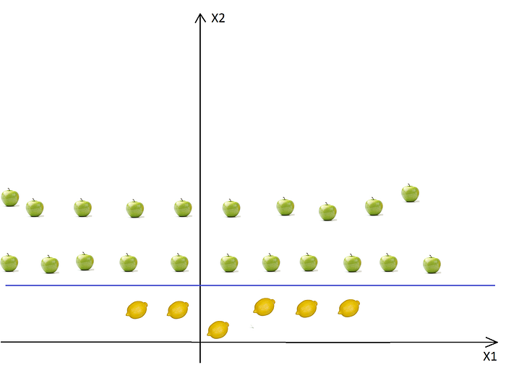
Simple example
In this case we cannot find a straight line to separate apples from lemons. So how can we solve this problem. We will use the Kernel Trick! (2D to 3D)

Slide 35
Function of Kernal
A kernel is a function used in SVM for helping to solve problems.
They provide shortcuts to avoid complex calculations.
The amazing thing about kernel is that we can go to higher dimensions and perform smooth calculations with the help of it.

Slide 36

Mapping into a New Feature Space
Φ : x → X = Φ(x)
Φ(x₁,x₂) = (x₁,x₂,x₁²,x₂²,x₁x₂)
Rather than run SVM on x_{i}, (original) run it on Φ(x_{i}) (Transform dimensional)
Find non-linear separator in input space
What if Φ(x_{i}) is really big?
Use kernels to compute it implicitly!
Image from http://web.engr.oregonstate.edu/
~afern/classes/cs534/

Slide 37
Kernels
Find kernel K such that
K(x₁,x₂) = < Φ(x₁), Φ(x₂)>
Computing K(x₁,x₂) should be efficient, much more so than computing Φ(x₁) and Φ(x₂)
Use K(x₁,x₂) in SVM algorithm rather than <x₁,x₂>
Remarkably, this is possible
Visit: https://www.youtube.com/watch?v=5l3mSlY2MsM

Slide 38
Kernel Functions Types
Linear: K(x_{i},x_{j})= x_{i}^{T}x_{j}
Mapping Φ: x → φ(x), where φ(x) is x itself
Polynomial of power p: K(x_{i},x_{j})= (C+ x_{i}^{T}x_{j})^{p}
Mapping Φ: x → φ(x), where φ(x) has dimensions; C- slack penalty factor
Gaussian (radial-basis function):
K(x_{i},x_{j}) =
Mapping Φ: x → φ(x), where φ(x) is infinite-dimensional: every point is mapped to a function (a Gaussian); combination of functions for support vectors is the separator.
.

Slide 39
The Polynomial Kernel
K(x₁,x₂) = < x₁, x₂ > ²
x₁ = (x₁₁, x₁₂)
x₂ = (x₂₁, x₂₂)
< x₁, x₂ > = (x₁₁x₂₁ + x₁₂x₂₂)
< x₁, x₂ > ² = (x₁₁² x₂₁² + x₁₂²x₂₂² + 2x₁₁ x₁₂ x₂₁ x₂₂)
Φ(x₁) = (x₁₁², x₁₂², √2x₁₁ x₁₂)
Φ(x₂) = (x₂₁², x₂₂², √2x₂₁ x₂₂)
K(x₁,x₂) = < Φ(x₁), Φ(x₂) >

Slide 40
Kernels
What does it mean to be a kernel?
K(x₁,x₂) = < Φ(x₁), Φ(x₂) > for some Φ
What does it take to be a kernel?
The Gram matrix G_{ij} = K(x_{i}, x_{j})
Positive definite matrix
Σ_{ij} c_{i} c_{j} G_{ij} ≥ 0 for c_{i,} c_{j} ∈ ℜ
Positive definite kernel
For all samples of size m, induces a positive definite Gram matrix

Slide 41
A Few Good Kernels
Dot product kernel
K(x₁,x₂) = < x₁,x₂ >
Polynomial kernel
K(x₁,x₂) = < x₁,x₂ >^{d} (Monomials of degree d)
K(x₁,x₂) = (< x₁,x₂ > + c)^{d} (All monomials of degree 1,2,…,d)
Gaussian kernel
K(x₁,x₂) = exp(-| x₁-x₂ |²/2σ²)
Radial basis functions:
Sigmoid kernel
K(x₁,x₂) = tanh(< x₁,x₂ > + ϑ)
Neural networks
Establishing “kernel-hood” from first principles is non-trivial

Slide 42
The Kernel Trick
“Given an algorithm which is formulated in terms of a positive definite kernel K₁, one can construct an alternative algorithm by replacing K₁ with another positive definite kernel K₂”
SVMs can use the kernel trick
To get more info on SVM, visit: https://www.youtube.com/watch?v=GcCG0PPV6cg

Slide 43
Using a Different Kernel in the Dual Optimization Problem
For example, using the polynomial kernel with d = 4 (including lower-order terms).
Maximize over α
W(α) = Σ_{i} α_{i} - 1/2 Σ_{i,j} α_{i} α_{j} y_{i} y_{j} <x_{i}, x_{j}>
Subject to
α_{i} ≥ 0
Σ_{i} α_{i} y_{i} = 0
Decision function
f(x) = sign(Σ_{i} α_{i} y_{i} <x, x_{i}> + b)
(<x_{i}, x_{j}> + 1)⁴
X
So by the kernel trick,
we just replace them!
These are kernels!
(<x_{i}, x_{j}> + 1)⁴
X

Slide 44
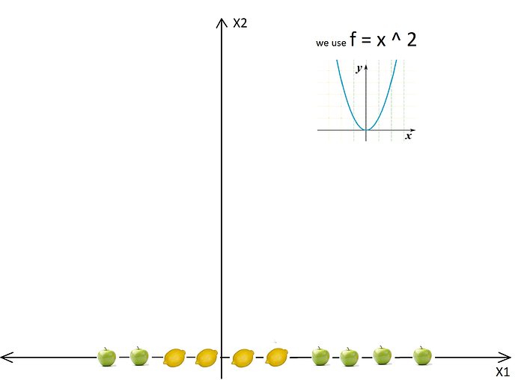
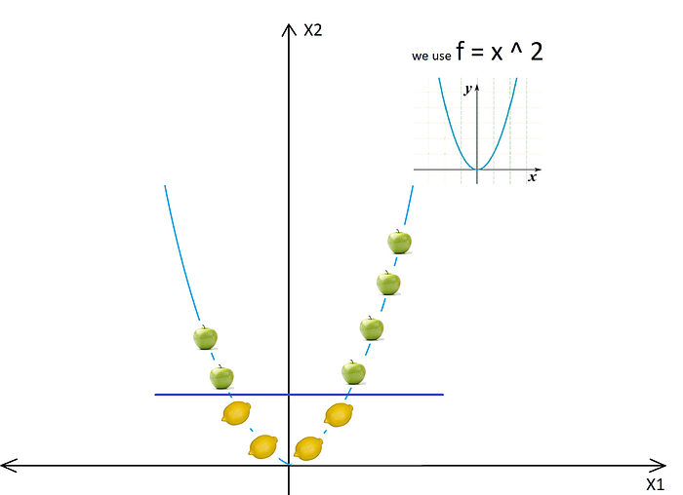
Regularization
Mapping 1D to 2D

Slide 45
So after the transformation, we can easily delimit the two classes using just a single line. (i.e, lemon and apple)
In real life applications we won’t have a simple straight line, but we will have lots of curves and high dimensions.
In some cases we won’t have two hyperplanes which separates the data with no points between them, so we need some trade-offs, tolerance for outliers.
Fortunately the SVM algorithm has a so-called regularization parameter to configure the trade-off and to tolerate outliers.

Slide 46
Regularization
The Regularization Parameter or slack penalty factor (in python it’s called C) tells the SVM optimization how much you want to avoid miss classifying each training example.
If the C is higher, the optimization will choose smaller margin hyperplane, so training data miss classification rate will be lower.
On the other hand, if the C is low, then the margin will be big, even if there will be miss classified training data examples.

Slide 47
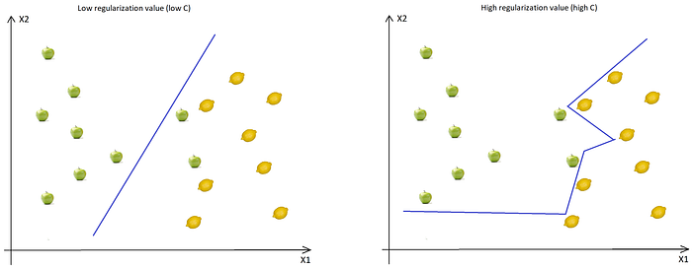

Slide 48
When the C is low, the margin is higher (so implicitly we don’t have so many curves, the line doesn’t strictly follows the data points) even if two apples were classified as lemons. (it leads to underfit).
When the C is high, the boundary is full of curves and all the training data was classified correctly.
Don’t forget, even if all the training data was correctly classified, this doesn’t mean that increasing the C will always increase the precision (it leads overfitting)

Slide 49
Gamma (γ=1/2σ²)
The next important parameter is Gamma. The gamma parameter (see RBF Kernal equation) defines how far the influence of a single training example reaches.
This means that high Gamma will consider only points close to the plausible hyperplane (chances of overfits) and low Gamma will consider points at greater distance (chances of underfits)

Slide 50
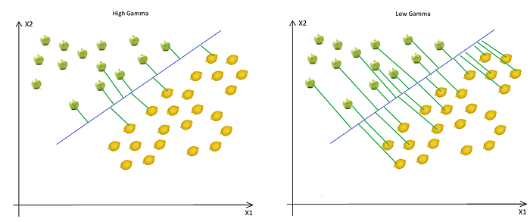

Slide 51
SVM Example using Python
# Fitting SVM to the Training set from sklearn.svm import SVC classifier = SVC(kernel = 'rbf', C = 0.1, gamma = 0.1) classifier.fit(X_train, y_train)

